Slide 1
Cloud Computing & Storage
&
Hands-on Data Analytics
Arcot (Raja) Rajasekar
rajasekar@unc.edu
Unit #02

Slide 2
Unit #02
Services in the Cloud
  Amazon Web Services
    EC2, S3, …
    Glacier
  Microsoft Azure
  Google Cloud Platform
  Private Clouds

Slide 3









Why Cloud?
Acquisition cost is 10% of IT Spend
software
hardware
network
facilities
IT labor
management tools
power/cooling
support
maintenance
security
disaster recovery
Operating cost is 90% of IT Spend
backup
Source: IDC

Slide 4
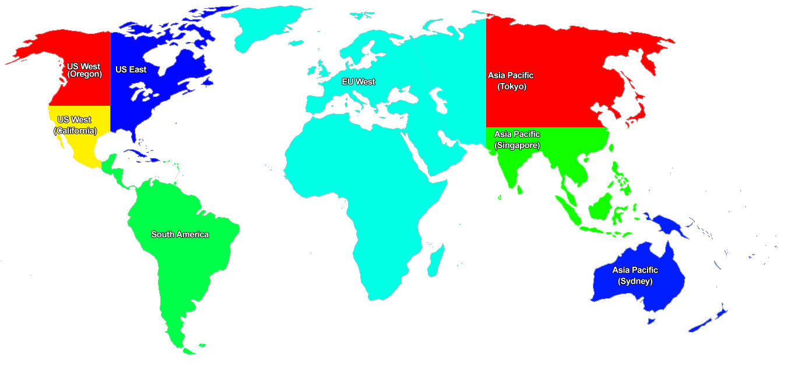
Amazon Web Services

Slide 5


Consumer Business
Seller Business
IT Infrastructure Business
Tens of millions of active customer accounts
Sell on Amazon websites
Use Amazon technology for your own retail website
Leverage Amazon’s massive fulfillment center network
Cloud computing infrastructure for hosting web-scale solutions
Eight countries: US, UK, Germany,
Japan, France, Canada, China, Italy
Hundreds of thousands of registered customers in over 190 countries

Slide 6
What is AWS?
AWS is Amazon’s umbrella description of all of their web-based technology services.
Mainly infrastructure services:
  Amazon Elastic Compute Cloud (EC2)
  Amazon Simple Storage Service (S3)
  Amazon Simple Queue Service (SQS)
  Amazon CloudFront
  Amazon SimpleDB
  Amazon Cloud Drive
  Amazon DynamDB
  …

Slide 7
EC2 - Storage Access
Internal Disks – File system
  disappears with the instance (transient)
External Storage
  SAN-like, persists across time
Cloud Storage - S3
independent of an instance
for archival purposes: (persistent)
Amazon: SimpleDB: Relational database.

Slide 8
AMI – Amazon Machine Image
Template Software Configuration
  Instance of a virtual server
  Operating System, Application Services, Applications and Packages
  AMI Marketplace
  Create your own image
Image of your server
  Replicate and launch any number of instance
Elastic IP address:
  Not static not dynamic but elastic;
  IP reserved for your use; disappears once the server is terminated.

Slide 9
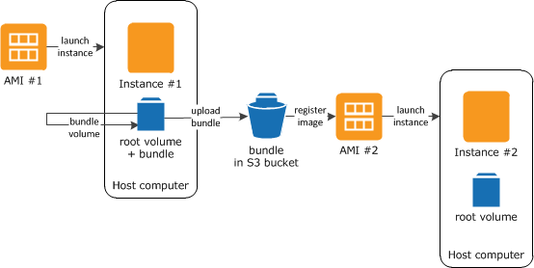
AMI Replication
From: http://docs.aws.amazon.com

Slide 10
S3 – Persistent Object Store
Model: Objects stored in buckets
  No concept of folders or directories
Location can be specified
  East Coast, West Coast, Europe
  Replication also possible
Amazon web services API support the ability to:
  Discover using meta data (key-value pairs)
  CRUD Operations
Buckets
  Flat namespace
  Names may contain only lowercase letters, numbers, periods, underscores, and dashes, and must start with a number or letter
  Create your own namespace with your own bcukets
Pricing Model
  Storage cost, Access cost
  Access cost is high – so good mainly for backup
  AWS (eg. EC2) access is free!!

Slide 11
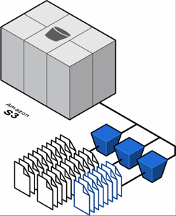
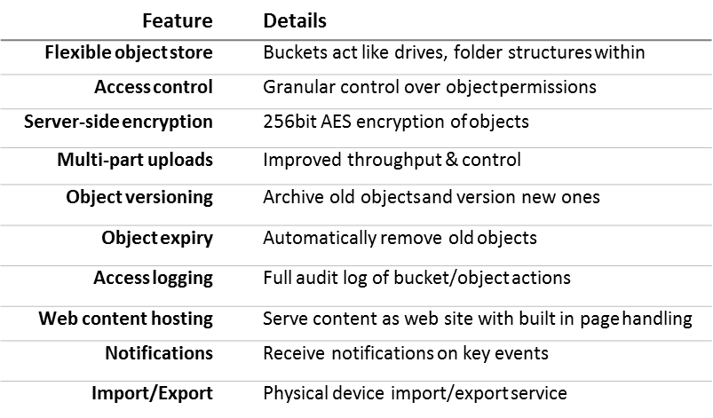
S3 Storage
Deployment & Administration
App Services
Compute
Storage
Database
Networking
AWS Global Infrastructure

Slide 12
Amazon EC2
EC2 provides web services API for provisioning, managing and accessing virtual servers inside the amazon cloud
One can lease compute nodes based on needs and
Applications anywhere on the Internet can launch a virtual server in the amazon cloud with a single web services call
  REST or SOAP WS

Slide 13
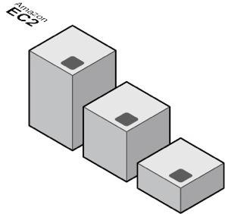
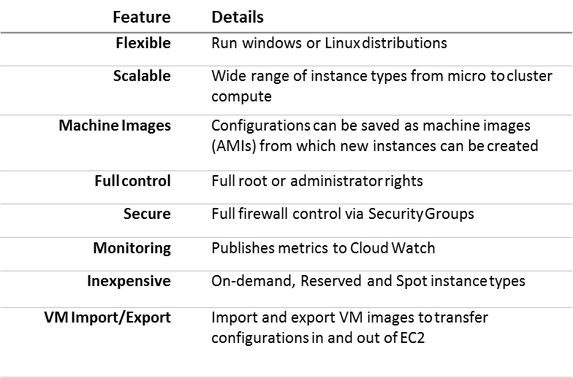
EC2 Compute
Vertical Scaling
From $0.02/hr
Deployment & Administration
App Services
Compute
Storage
Database
Networking
AWS Global Infrastructure

Slide 14
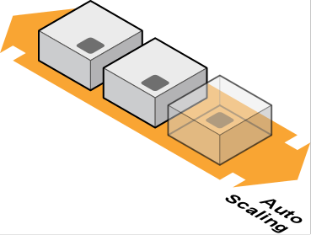
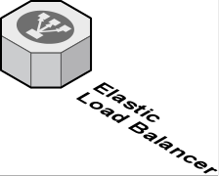


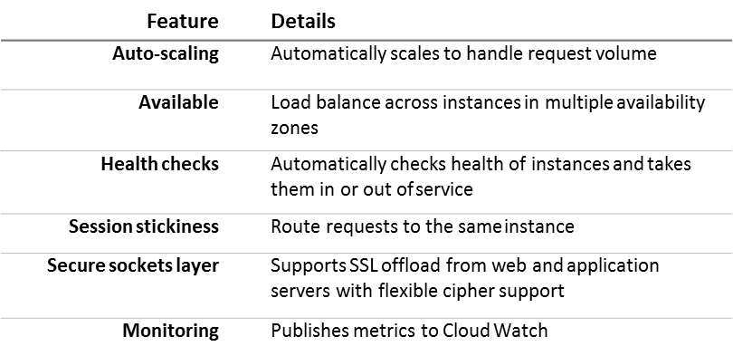
Compute
Elastic Load Balancing
Create highly scalable applications
Distribute load across EC2 instances in multiple availability zones
Deployment & Administration
App Services
Compute
Storage
Database
Networking
AWS Global Infrastructure

Slide 15
Application
Maintain a library of AMIs for the business
  Make images
  Contain legacy systems or company-specific systems
  Test AMIs
Launch instances for non-technical but domain experts to work with.
  What will you provide them so that they can start working?
  Replicate as demand grows
Use S3 for archival storage and shared storage

Slide 16
Amazon CloudFront
Content Distributing Network (CDN)
  enables you to place the content at the edges of the network for rapid delivery (low latency)
  Used for web site deployment
  Multiple copies of data,
  Meet performance demands
    Nearest data
Application Model
  Place the contents in S3/EC2/…
  Run applications from anywhere and the content is moved to where the application is (to the edges)

Slide 17
Amazon Glacier
Archiving & long-term backup
Durable storage! Ever!!
Cheap: $0.007 per gigabyte per month
Compared to S3: 0.03 GB per month
Retrieval time in hours!!
Lowers administrative burden
Integrated into S3 – hierarchical storage
Applications:
  Patient records – compliance
  Media storage (eg. tape replacement)

Slide 18
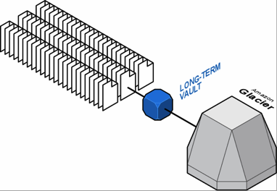
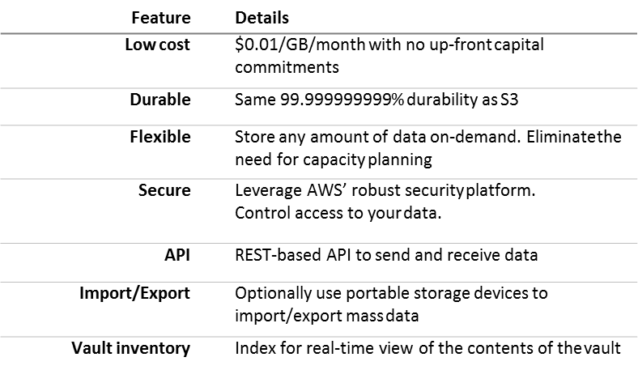
Glacier Storage
Storage
Deployment & Administration
App Services
Compute
Storage
Database
Networking
AWS Global Infrastructure

Slide 19
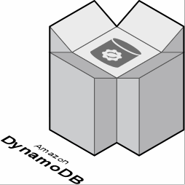
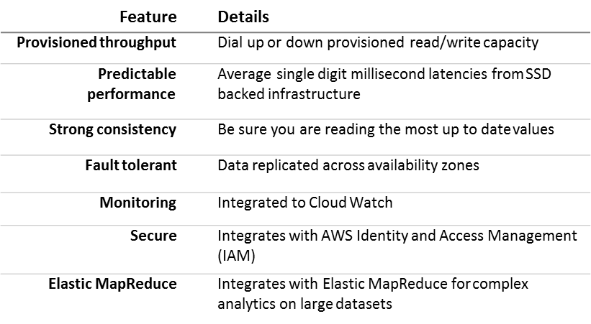
DynamoDB Database
Deployment & Administration
App Services
Compute
Storage
Database
Networking
AWS Global Infrastructure

Slide 20
AWS GovCloud
“AWS GovCloud (US) is an isolated AWS region designed to host sensitive data and regulated workloads in the cloud, ensuring that this work meets the US government's compliance requirements.”
ITAR and FedRAMP compatible
Products:
  Compute: EC2, ELB (Elastic Load Balancing), …
  Storage: S3, Glacier, EBS (Elastic Block Storage), …
  Database: RDS, DynamoDB, ElasticCache, …
  Analytics: EMR, …
  https://aws.amazon.com/govcloud-us/

Slide 21
Costing Amazon
Compute Costing: Free Tier: 750 hours EC2, 30GB EBC, 15GB out band
T2: Burstable Performance; M4: General Purpose; G2:GP+GPU; D2: Dense Storage
On Demand | vCPU | ECU | Memory GiB | Storage type | Linux Price ($) per hour
T2.nano | 1 | variable | 0.5 | EBS | 0.0065
M4.10xlarge | 40 | 124.5 | 160 | EBS | 2.394
G2.8xlarge | 32 | 104 | 60 | 2x12 SSD | 2.60
D2.8xlarge | 36 | 116 | 244 | 24x2000 HDD | 5.52
Reserved Instances | Duration | Charge ($) | Effective Hourly Rate | Compared to OnDemand
T2.nano | 1 year | 38 | 0.0045 | 0.0065
T2.nano | 3 year | 76 | 0.0029 | 0.0065
M4.10xlarge | 3 year | 23,468 | 0.893 | 2.394
G2.8x.large | 3 year | 29,640 | 1.1279 | 2.60
D2.8xlarge | 3 year | 41,560 | 1.5814 | 5.52

Slide 22
Costing Amazon
Storage Costing: Free Tier: 5 GB S3 storage, 20,000 Get Requests, 2,000 Put Requests, and 15GB of data transfer out each month for one year
Storage Cost | S3 | S3-infreq access | Glacier
First 1TB/month | 0.03 per GB | 0.125 per GB | 0.007 per GB
50-500TB/month | 0.029 per GB | 0.125 per GB | 0.007 per GB
Over 5000 TB/month | 0.0275 per GB | 0.125 per GB | 0.007 per GB
Request Cost | S3 | S3-infreq access | Glacier
Ingestion | 0.005 per 1000 puts | 0.01 per 1000 puts | 0.05 per 1000 puts
Access | 0.004 per 10,000 puts | 0.01 per 10,000 puts | 0.05 per 1000 puts
Data Transfer Cost/month | S3 per GB | S3-infreq access per GB | Glacier per GB
Ingestion | 0.0000 | 0.01 | 0.0000
Access | 0.09 up to 10TB 0.05 after 100TB | 0.01 | 0.01 if > 5%stored

Slide 23
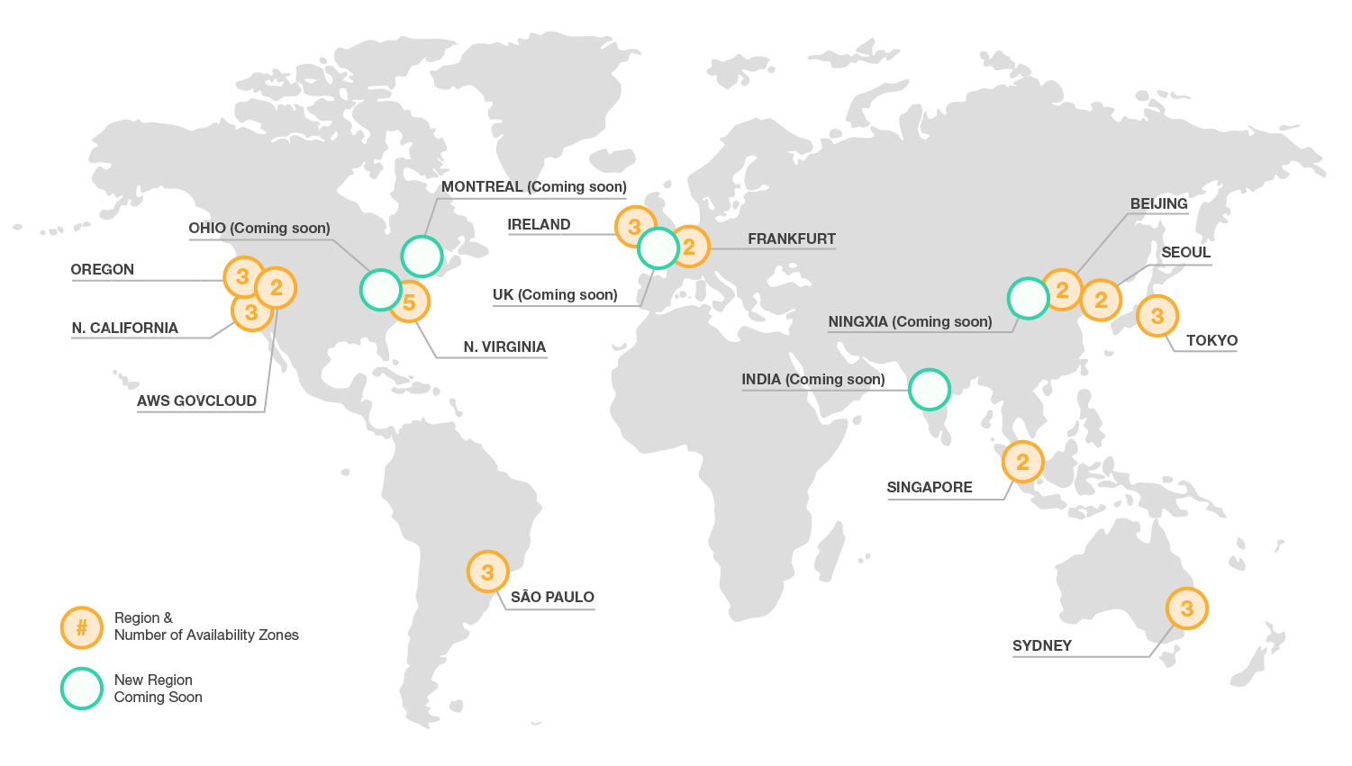
AWS Infrastructure

Slide 24
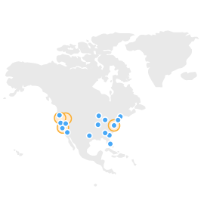
North America
US East (Northern Virginia) Region
EC2 Availability Zones: 5*
Launched 2006
US West (Northern California) Region
EC2 Availability Zones: 3*
Launched 2009
US West (Oregon) Region
EC2 Availability Zones: 3
Launched 2011
AWS GovCloud (US) Region
EC2 Availability Zones: 2
Launched 2011
AWS Edge Locations: Ashburn, VA (3), Atlanta, GA, Chicago, IL, Dallas/Fort Worth, TX (2),
Hayward, CA, Jacksonville, FL, Los Angeles, CA (2), Miami, FL, New York, NY (3), Newark, NJ,
Palo Alto, CA, San Jose, CA, Seattle, WA, South Bend, IN, St. Louis, MO

Slide 25
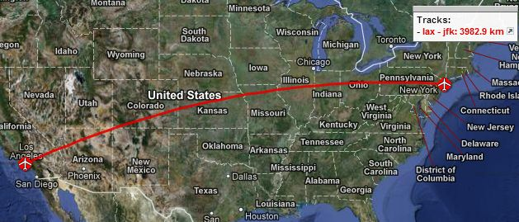
Availability Zones?
Challenges with traditional asynchronous replication between distant data centers
  Committing to an SLA order 1 to 2 milliseconds
  But L.A. to New York is 74 milliseconds round-trip
  You can’t wait 74 milliseconds to commit a transaction
Traditional failure, difficult decision:
  Fail over and lose transactions?
  Don’t fail over and lose availability?
  Difficult choice
AZs for no-admin failover
  Sync works when < 2 milliseconds
  Combine with regional replication for
  very high availability (VHA)
74 milliseconds

Slide 26

























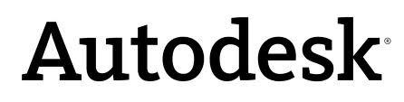









Enterprises Using AWS

Slide 27
Microsoft’s Azure
Platform as a Service
  Application Platform in the Cloud
Provisions:
  Compute
    Web, Worker & VM Role
  Storage
    Blob, Table, Queue & Azure SQL Server
  Application Fabric
    Service Bus, Access Control, (Future: Cache, Integration & Composite)

Slide 28
Azure Model
Azure is an OS for the data center
  Model: Treat the data center as a machine
  Handles resource management, provisioning, and monitoring
  Manages application lifecycle
  Allows developers to concentrate on business logic
Provides shared pool of compute, disk and network
  Virtualized storage, compute and network
  Illusion of boundless resources
Provides common building blocks for distributed applications
  Reliable queuing, simple structured storage, SQL storage
  Application services like access control and connectivity

Slide 29
Microsoft Azure Components
 | Windows Azure PaaS
Applications | Windows Azure Service Model
Runtimes | .NET 3.5/4, ASP .NET, PHP
Operating System | Windows Server 2008/R2-Compatible OS
Virtualization | Windows Azure Hypervisor
Server | Microsoft Blades
Database | SQL Azure
Storage | Windows Azure Storage (Blob, Queue, Table)
Networking | Windows Azure-Configured Networking

Slide 30


2. What is Google App Engine
Google App Engine (GAE) is a Platform as a Service (PaaS) cloud computing platform for developing and hosting web applications in Google-managed data centers.
Google App Engine lets you run web applications on Google's infrastructure.
Easy to build.
Easy to maintain.
Easy to scale as the traffic and storage needs grow.
Yes, free for upto 1 GB of storage and enough CPU and bandwidth to support 5 million page views a month. 10 Applications per Google account.
Free ???

Slide 31
2. Google App Engine Components
Language Support:
  Java
  Python
  Go
  PHP
Data Storage:
  App Engine DataStore (NoSQL)
  CloudSQL (similar to MySQL)
  Google Cloud Store (file storage)
Other services:
  URL Fetch
  Email
  Sandbox security
  Memcache (in-memory key-value storage)

